Slide 1
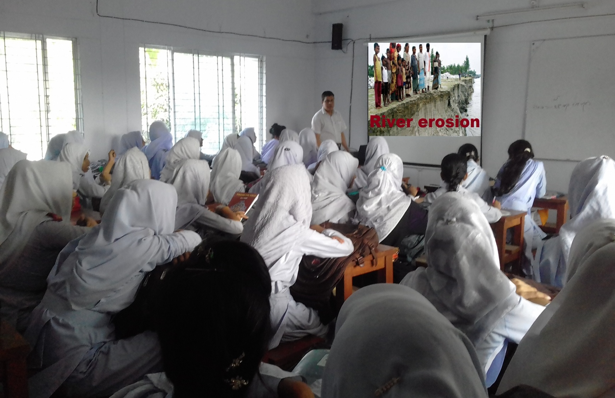
Welcome

Slide 2
Introduction of the teacher & class
Md. Jahangir Alam
Assistant Teacher (Eng)
Majhira Model High School
Shajahanpur, Bogura.
Mo. No: 01719-944601
Email:alam2014jahangir@gmail.com
Class-ix & x
English 1st Paper
Unit-5, Lesson-1
Time: 50 minutes.

Slide 3
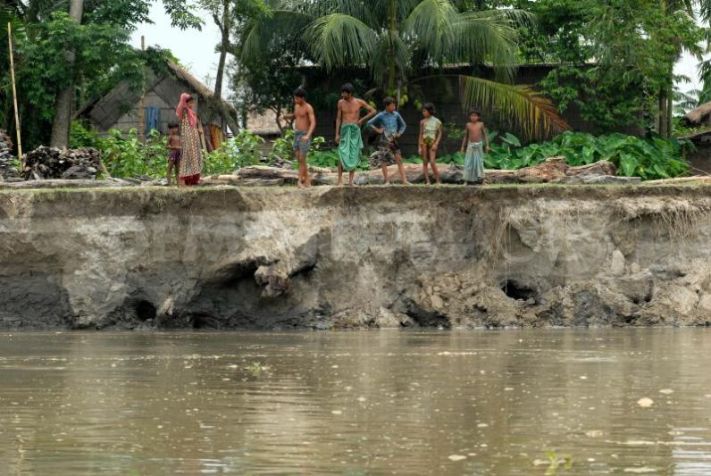
What do you see in the picture?
River erosion in Bangladesh.

Slide 4
Let’s enjoy a video

Slide 5
Our Today’s Lesson is-
The greed of the
roaring rivers

Slide 6
Learning Outcomes
After we have studied this lesson, we will be able to.
ask and answer questions.
infer meaning from context.
describe about river erosion in Bangladesh.
write a paragraph.

Slide 7
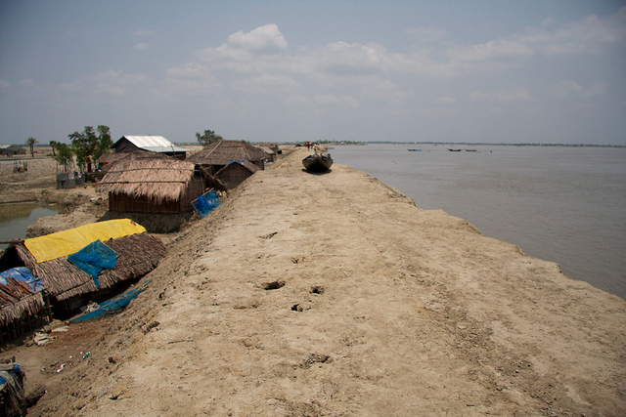
Let us introduce with some ke words.
Embankment
bank
ridge
dam
Meherjan lives in a slum on the Sirajgonj Town Protection Embankment.

Slide 8
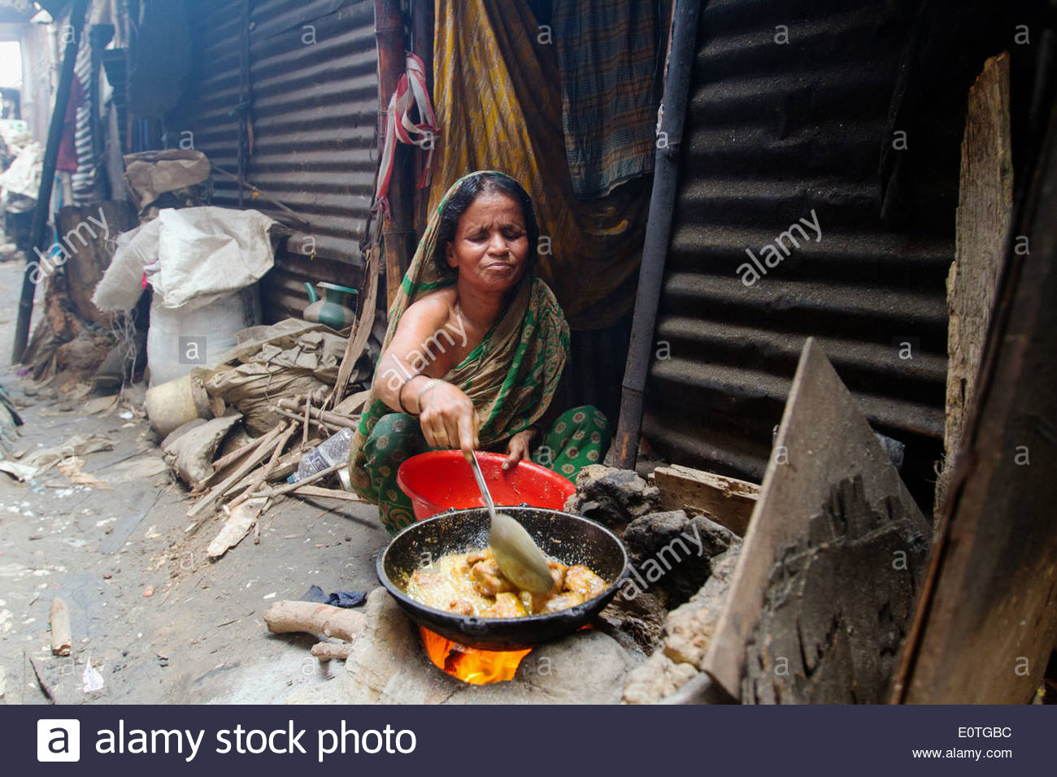
Turmoil
chaos
havoc
confusion
The dancing of the flames reminds Meherjan of the turmoil in her life.

Slide 9
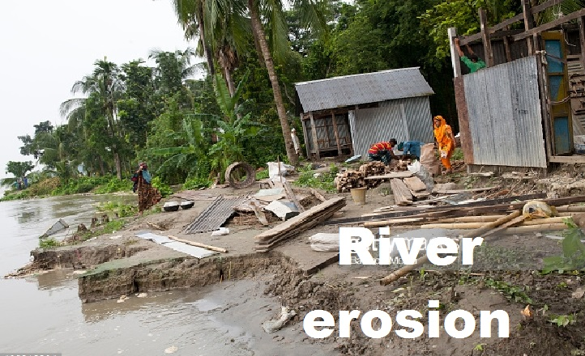
Demolish
defeat
thrash
devour
It took the river only a day to demolish Meher’s house, trees, vegetable garden and the bamboo bush.

Slide 10
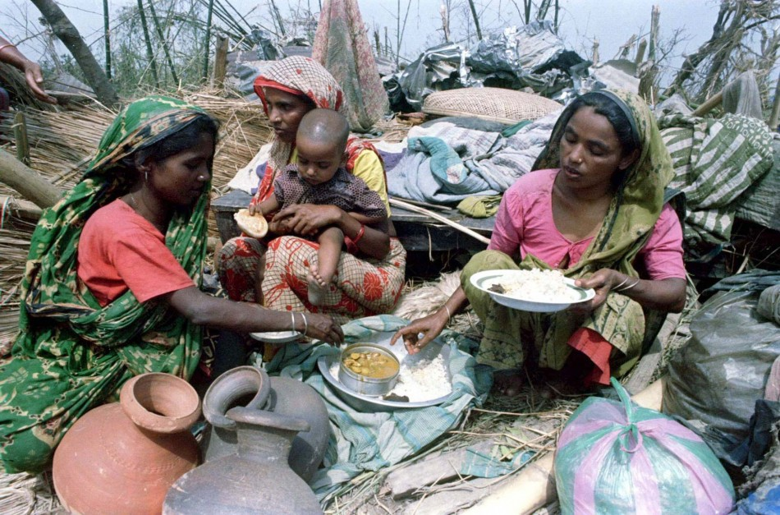
Shattered
crushed
horrified
suffering
The greedy Jamuna has shattered their dreams and happiness.

Slide 11
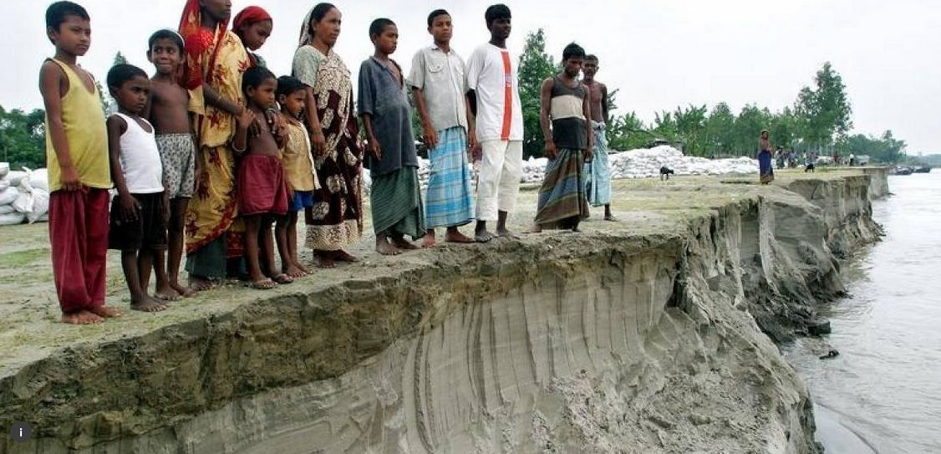
Threatened
exposed
helpless
defenseless
Many villages are threatened by the roaring of rivers.

Slide 12
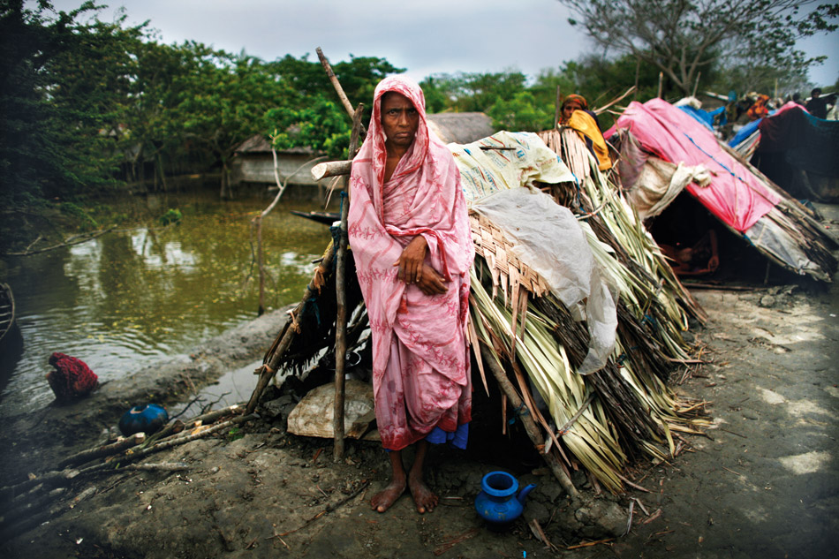
P
R
E
S
E
N
T
A
T
I
O
N
Meherjan lives in a slum on the Sirajgonj Town Protection Embankment. Her polythene roofed shelter looks like a cage.

Slide 13
P
R
E
S
E
N
T
A
T
I
O
N
In front of her shelter, she is trying to make a fire to cook the day’s only meal.

Slide 14
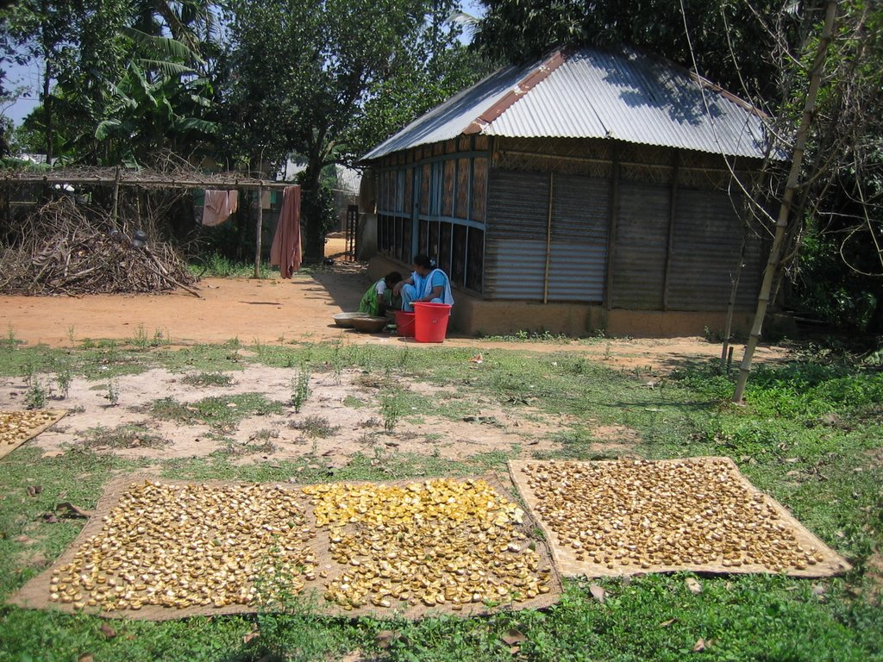
P
R
E
S
E
N
T
A
T
I
O
N
Not long ago Meherjan had everything--- a family, cultivable land and cattle.

Slide 15
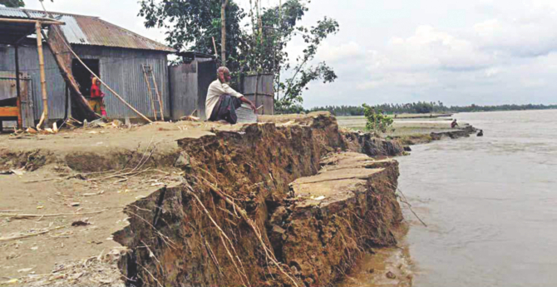
P
R
E
S
E
N
T
A
T
I
O
N
It took the river only a day to demolish Meher’s house, trees, vegetable garden and the bamboo bush.

Slide 16
☞ Who is Meherjan ?
Ans: Meherjan is an ill fated woman who lost everything through
the greed of river Jamuna.

Slide 17
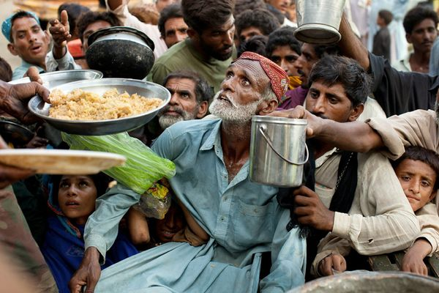
P
R
E
S
E
N
T
A
T
I
O
N
She lost her husband and her family to diseases that cruel hunger and poverty brought to the family.

Slide 18
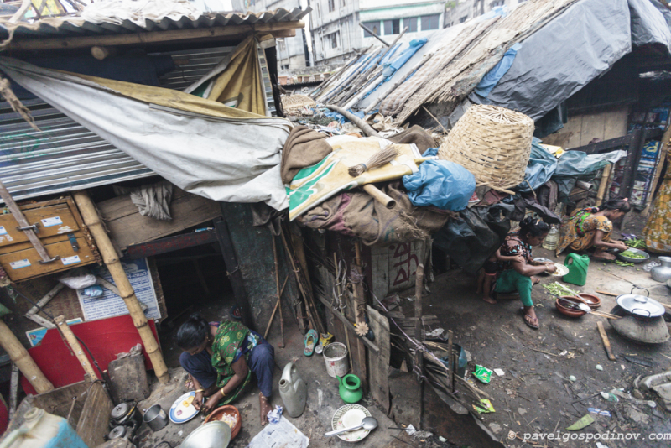
P
R
E
S
E
N
T
A
T
I
O
N
There are thousand others waiting to share the same fate with Meherjan.

Slide 19
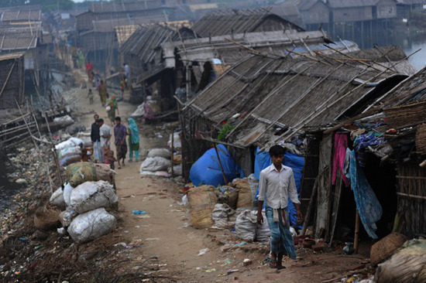
P
R
E
S
E
N
T
A
T
I
O
N
It is estimated that river erosion makes at least 100,000 people homeless every year in Bangladesh.

Slide 20
Meherjan lives in a slum on the Sirajgonj Town Protection Embankment. Her polythene roofed shelter looks like a cage. She is nearly 45 but looks more than her age. In front of her shelter, she is trying to make a fire to cook the day’s only meal. Her weak hands tremble as she adds some fallen leaves and straw to the fire. The whispering wind from the river Jamuna makes the fire unsteady. The dancing of the flames reminds Meherjan of the turmoil in her life. Not long ago Meherjan had everything--- a family, cultivable land and cattle. The erosion of the Jamuna consumed gradually all her landed property. It finally claimed her last shelter during the last monsoon. It took the river only a day to demolish Meher’s house, trees, vegetable garden and the bamboo bush. She had a happy family once. Over the years, she lost her husband and her family to diseases that cruel hunger and poverty brought to the family. Now, she is the only one left to live on with the loss and the pain. The greedy Jamuna has shattered her dreams and happiness.
There are thousand others waiting to share the same fate with Meherjan. Bangladesh is a land of rivers that affect its people. Erosion is a harsh reality for the people living along the river banks. During each monsoon many more villages are threatened by the roaring of rivers like the Jamuna, the Padma and the Meghna. It is estimated that river erosion makes at least 100,000 people homeless every year in Bangladesh. In fact, river erosion is one of the main dangers caused by climate change. If we can’t take prompt actions to adapt to climate change, there will be thousands of more Meherjans in our towns and villages every year.
Meherjan lives in a slum on the Sirajgonj Town Protection Embankment. Her polythene roofed shelter looks like a cage. She is nearly 45 but looks more than her age. In front of her shelter, she is trying to make a fire to cook the day’s only meal. Her weak hands tremble as she adds some fallen leaves and straw to the fire. The whispering wind from the river Jamuna makes the fire unsteady. The dancing of the flames reminds Meherjan of the turmoil in her life. Not long ago Meherjan had everything--- a family, cultivable land and cattle. The erosion of the Jamuna consumed gradually all her landed property. It finally claimed her last shelter during the last monsoon. It took the river only a day to demolish Meher’s house, trees, vegetable garden and the bamboo bush. She had a happy family once. Over the years, she lost her husband and her family to diseases that cruel hunger and poverty brought to the family. Now, she is the only one left to live on with the loss and the pain. The greedy Jamuna has shattered her dreams and happiness.
There are thousand others waiting to share the same fate with Meherjan. Bangladesh is a land of rivers that affect its people. Erosion is a harsh reality for the people living along the river banks. During each monsoon many more villages are threatened by the roaring of rivers like the Jamuna, the Padma and the Meghna. It is estimated that river erosion makes at least 100,000 people homeless every year in Bangladesh. In fact, river erosion is one of the main dangers caused by climate change. If we can’t take prompt actions to adapt to climate change, there will be thousands of more Meherjans in our towns and villages every year.
Silent reading

Slide 21
Pair work
Answers:
Write answer the following questions.
a) Meherjan uses some fallen leaves and straw to make fire for cooking her meals.
a) What does Meherjan use to make fire for cooking her meals?
b) What property did Meherjan lose due to river erosion?
c) What do you know about Meherjan’s family?
d) In which season does river erosion most likely occur?
e) Why is the phrase ‘greedy Jamuna’ used to describe the river? What greed do you notice in the description?
b) Meherjan lost everything includes her house, cultivable land, cattle, vegetable garden, bamboo bush and family due to river erosion.
c) Meherjan’s lost her family due to river erosion. Her husband, and other family members died of disease that hunger and poverty brought to the family.
d) In monsoon river erosion most likely occurs.
e) The Jomuna took everything away from the people living on the bank of it like Meherjan. That is why the phrase ‘greedy Jamuna’ used to describe the river. The river Jamuna took everything on its way without any reason and it is shown like consumption.

Slide 22
Evaluation
Click here for correct answer
Roaring rivers mean-
a rivers that flow strongly making wild sounds.
b rivers having many rowing boats in them.
c rivers that make people cry out.
d rivers that have noisy fishes.
3. whispering wind-
a. wind that blows from across the river.
b. wind that blows with a hissing sound.
c. wind that helps someone make a fire.
d. wind that blows in summer.
4. dancing of the flame a-
a. traditional form of folk dance
b. a flame that makes people dance around it.
c. a flame that is made unstable by the blast of air.
d. a flame made by people to remember their pasts.
2. Landed property-
a. a rented piece of land.
b. a piece of land on the bank of a river.
c. property in the form a source of income to its owner.
d. property used only as an agricultural farm.

Slide 23
Group Work
Complete the summery of Meherjan’s life with words/phrases from the box.
victims
affects
close to
slum dweller
homeless
threats
example
due to
shortage of food
one lakh
Meherjan is a typical (a) ………………… woman who lives in a slum. She lost her shelter and properties (b) ………………… the erosion of river Jamuna. She also lost her family. Her husband had died of diseases caused by poverty and (c) ………………………… Now, she is only a (d) ………………… . Like Meherjan there are many people who have become the (e) ………………… of river erosion. River erosion is still posing (f) ………………… to the lives and properties of thousands of people. People living (g) ………………… the rivers are the most likely victims of river erosion. Each year about (h) ………………… people become homeless due to river erosion in Bangladesh. Meherjan’s life is just one (i) ………………… of how climate change (j) ………………… the lives of thousands of people

Slide 24
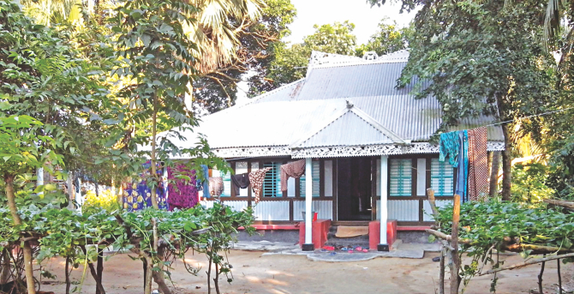
Home Work
Write about a paragraph about ill fate of Meherjan.

Slide 25
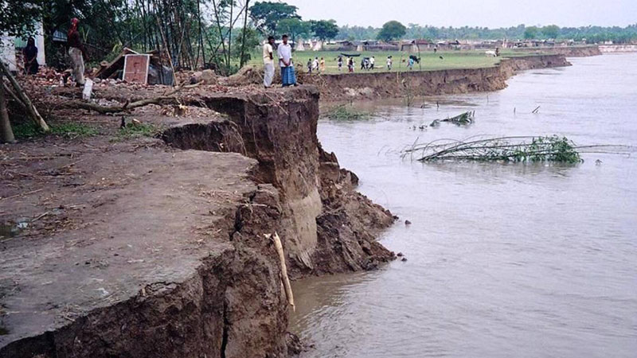
THANK YOU
See you again

